Slide 1
Learning JBoss7

Slide 2
Objectives
Jboss 7 arch
Jboss7 start and stop
Deployments
JDBC
JMS
Cluster
Replication

Slide 3
Installing Jboss AS 7

Slide 4
Learning Goal
Install JDK
Install JBoss 7 AS
Start JBoss AS
Stop JBoss AS

Slide 5
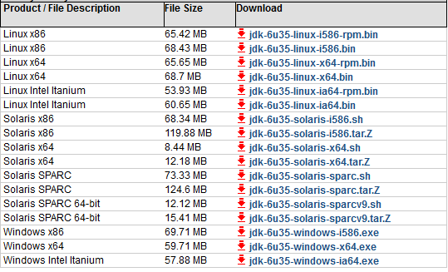
Install and Configure JDK
Download JDK 1.6 with latest Updates

Slide 6
/host=master:shutdown => stop the domain controller
/host=slave:shutdown => stop the slave host controller if you have such second instance running in the same domain
/host=master/server-config=server-one:stop
The given server instance (here server-one) is stopped, but not removed from config, so if you re-start the domain the server is up again

Slide 9
Install JBoss 7 AS
Download Jboss 7.1.x from http://www.jboss.org/jbossas/downloads/
Unzip it in your preferred location
Open a terminal window
Navigate to <JBOSS_HOME>/bin
Start Jboss in standalone or domain mode

Slide 10
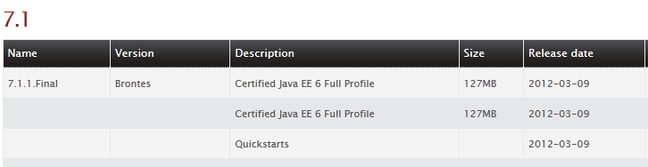

Slide 16
JBoss Architecture

